Slide 1

GEOG 4/590: Geospatial Data Science
Lecture 3: Gridded data analysis
Email: jryan4@uoregon.edu
Office: 163A Condon Hall
Office hours: Monday 15:00-16:00 and Tuesday 14:00-15:00

Slide 2
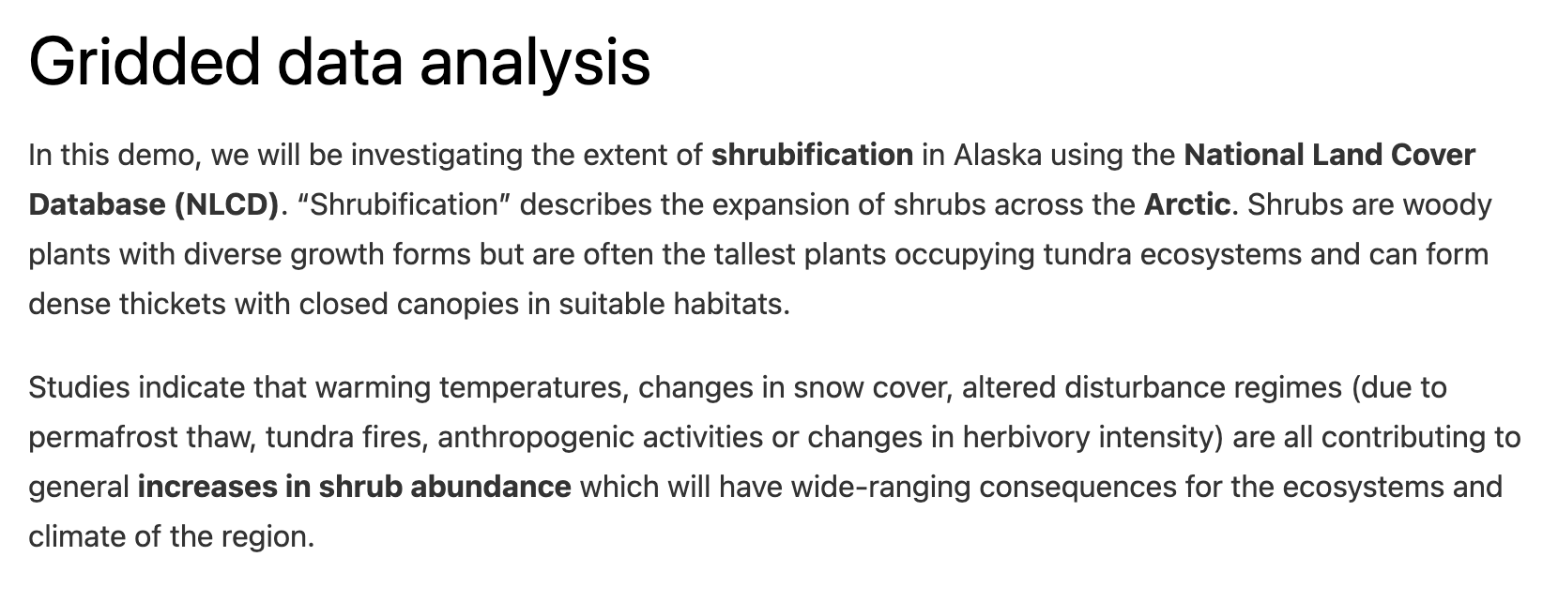
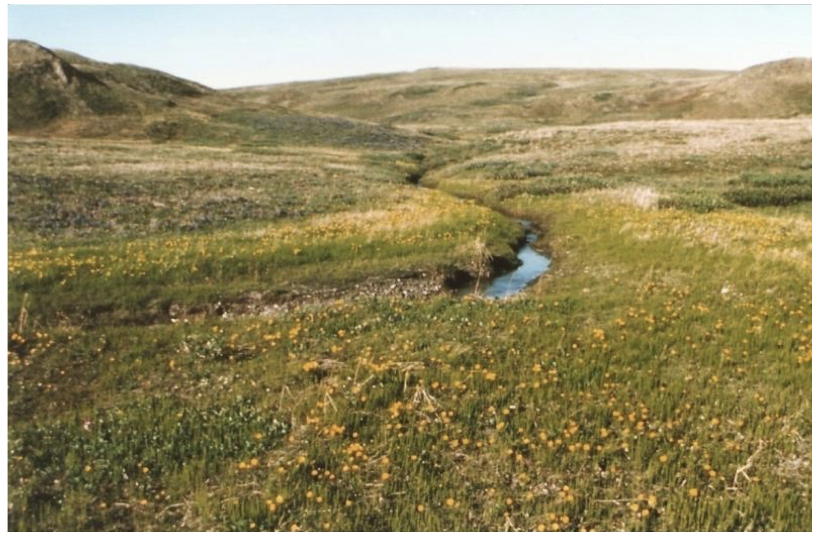
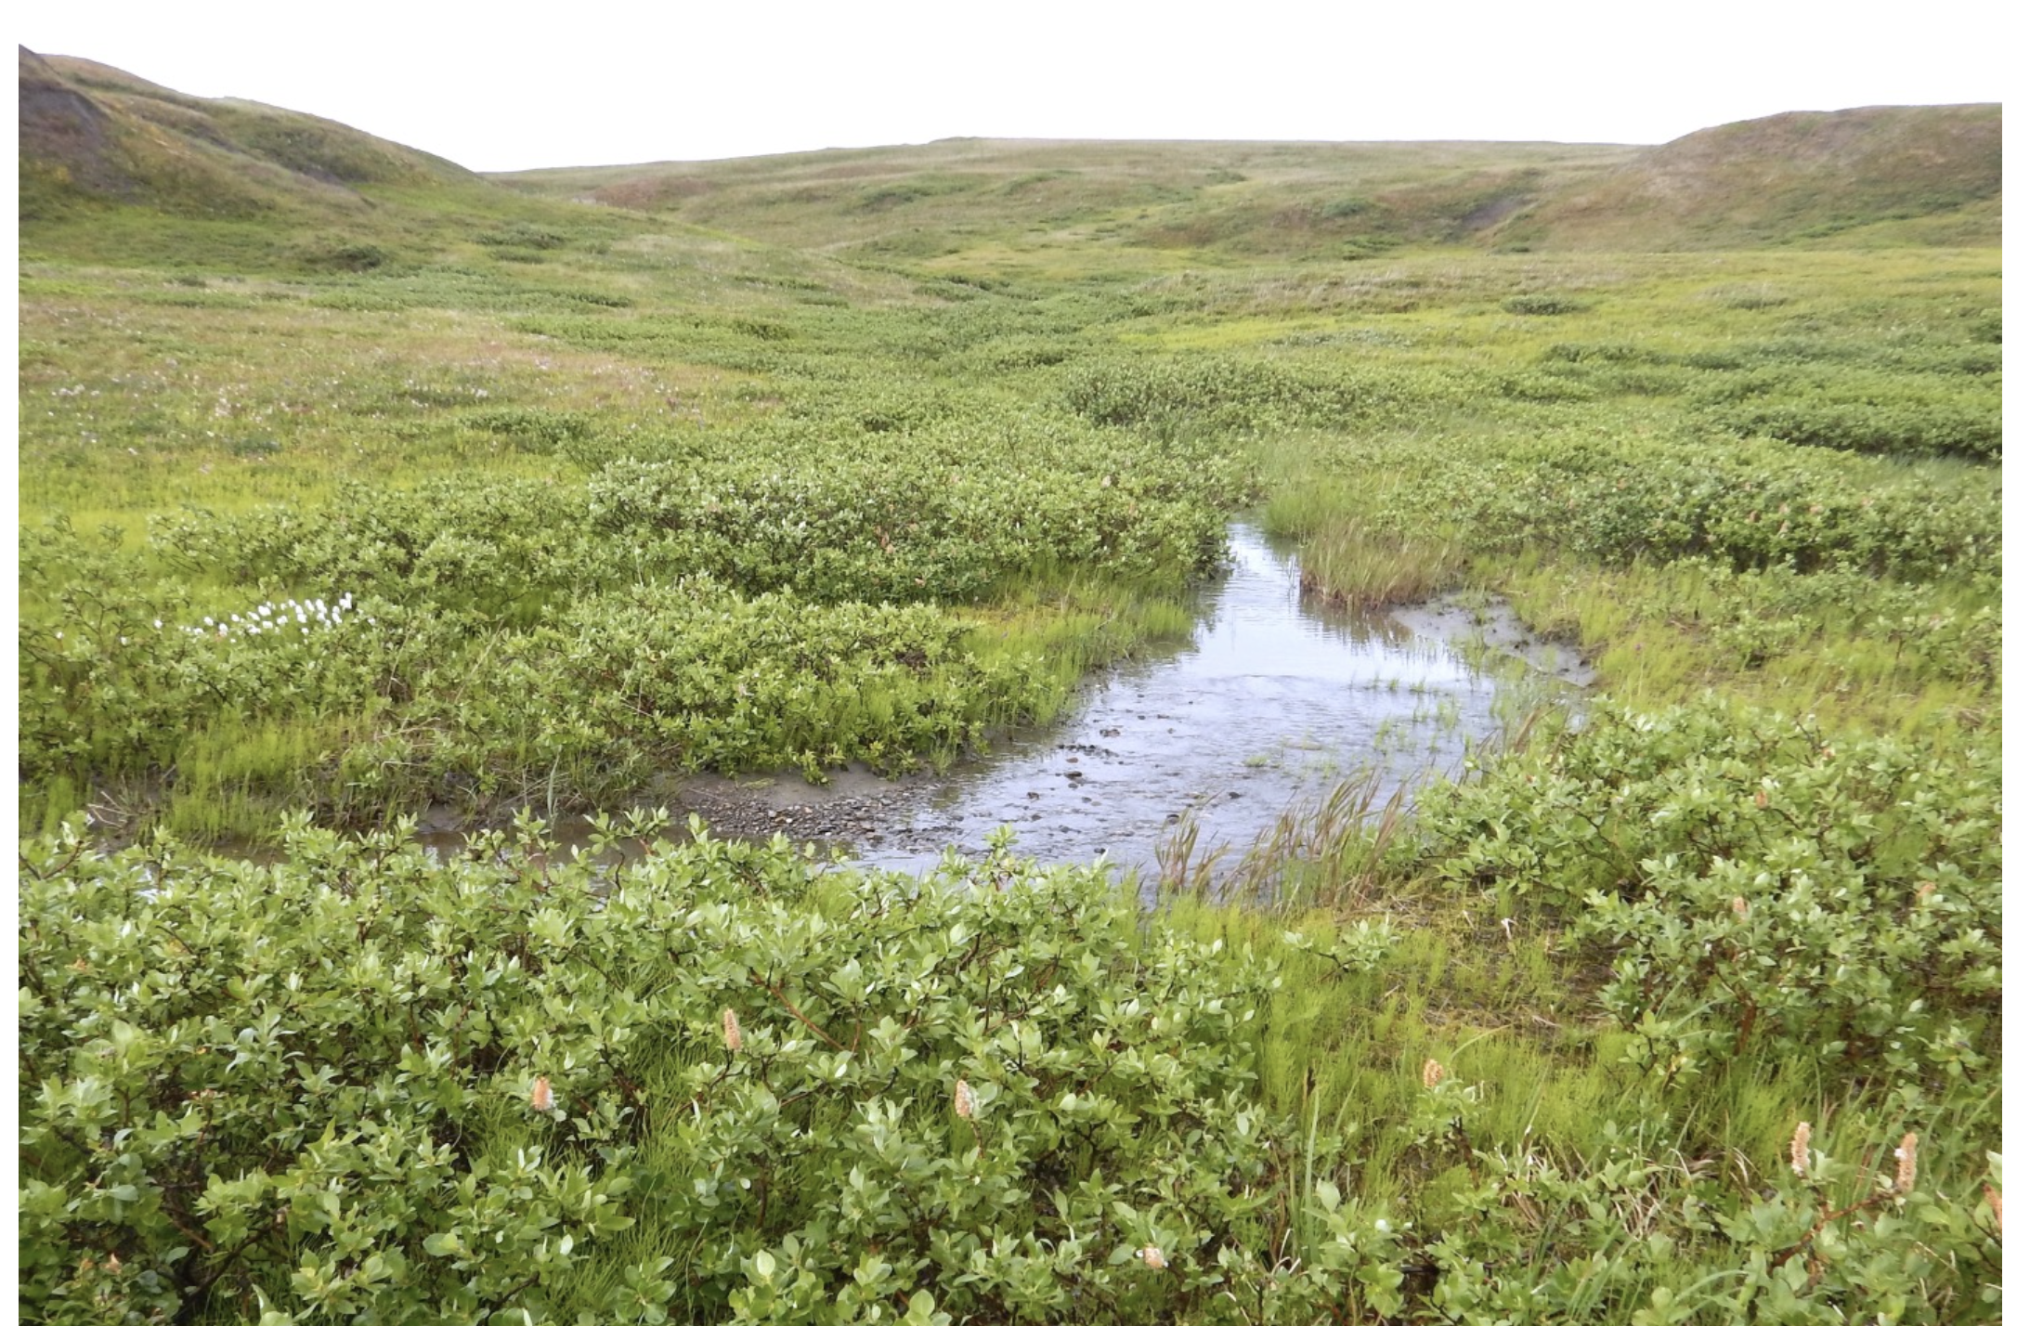

Slide 3
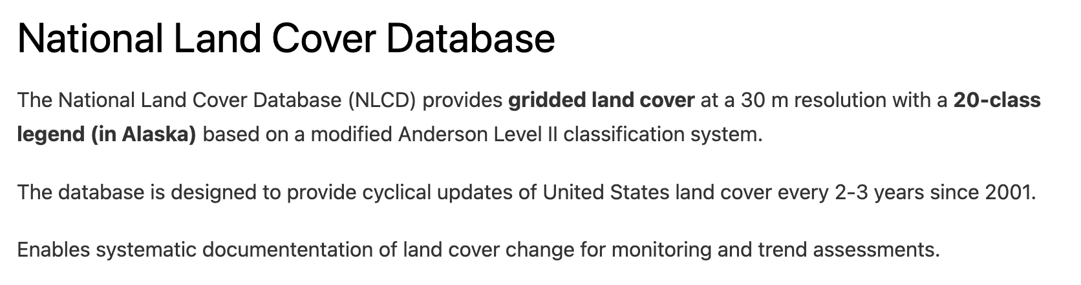
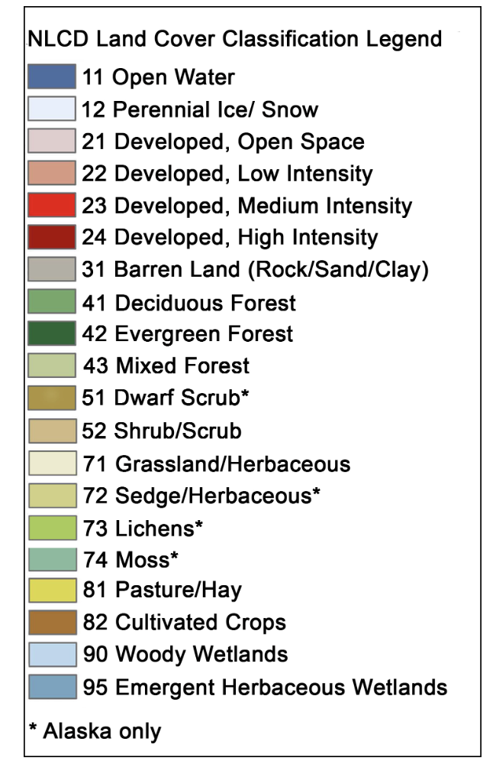
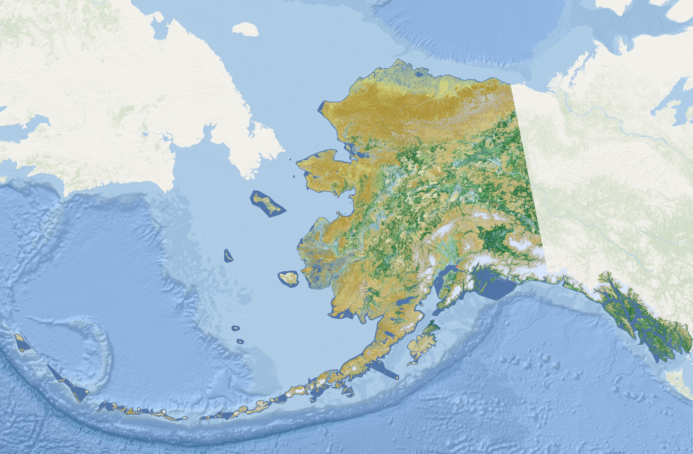

Slide 4
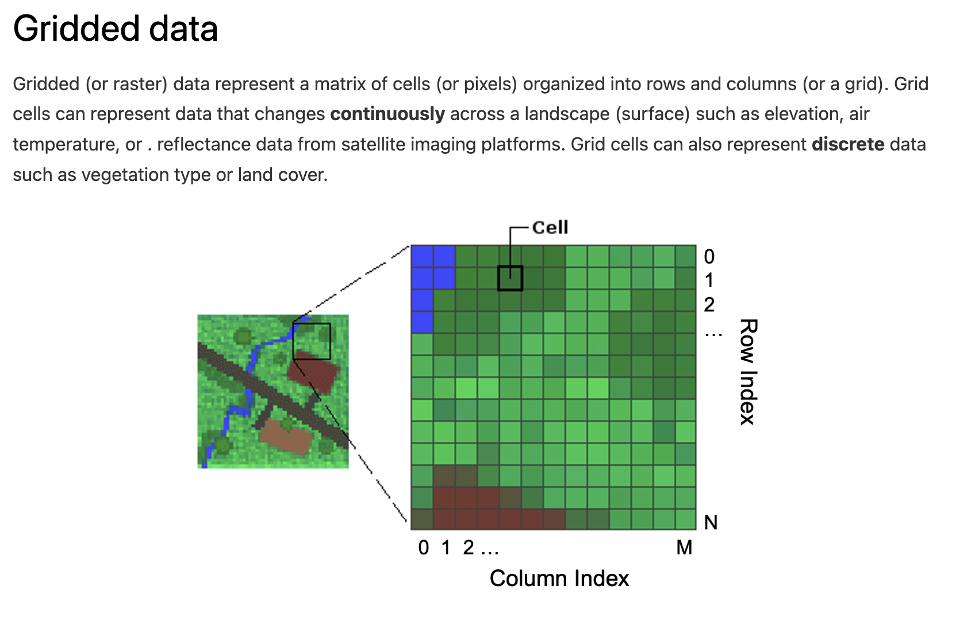

Slide 5
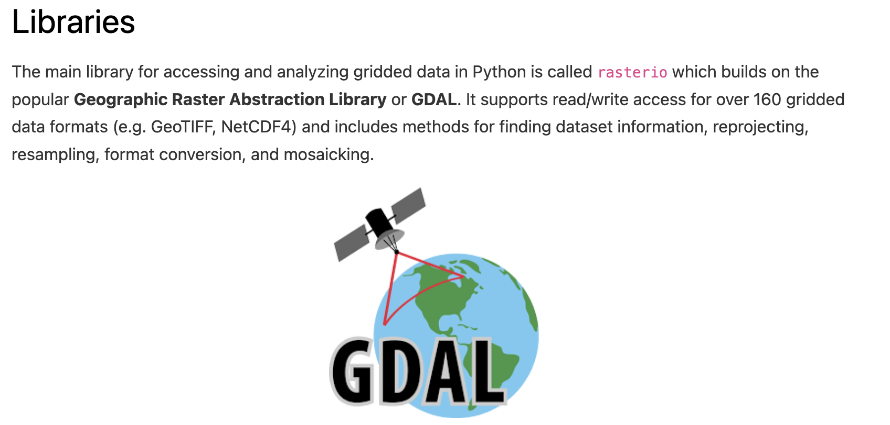

Slide 6
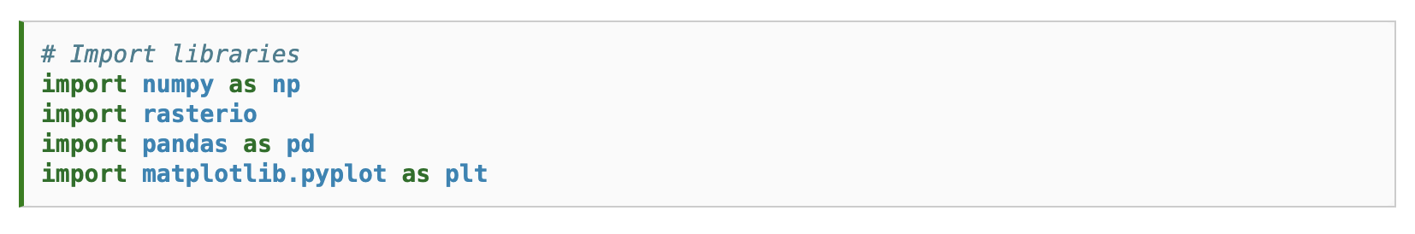

Slide 7
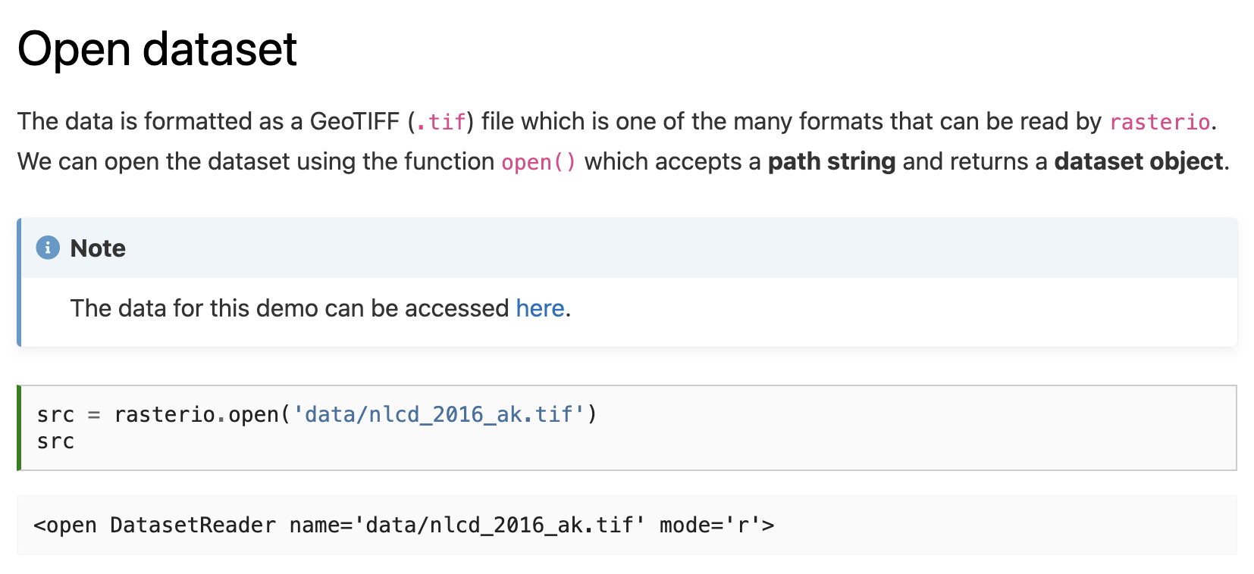

Slide 8
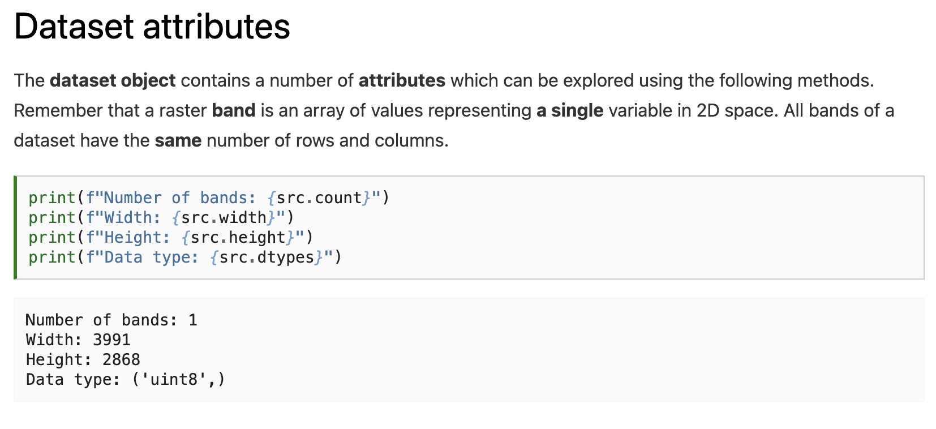
Notes:
How many different values can be stored in an uin8?

Slide 9
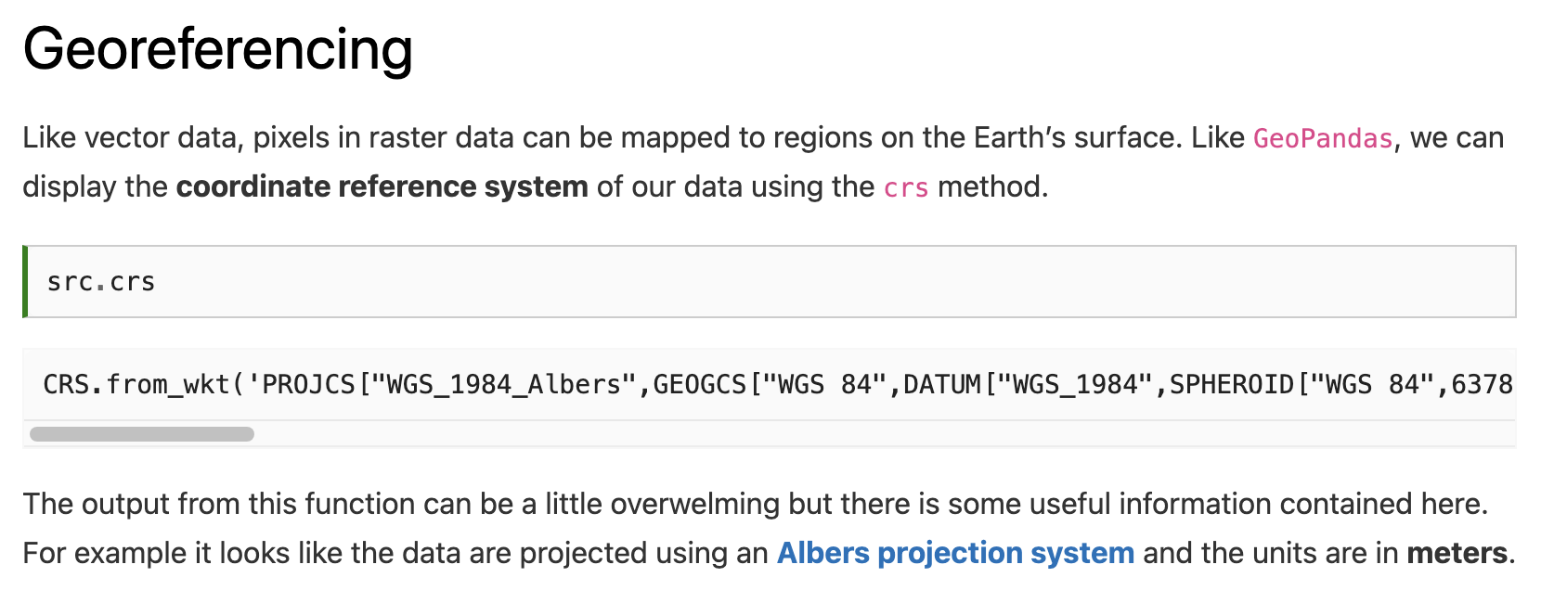

Slide 10
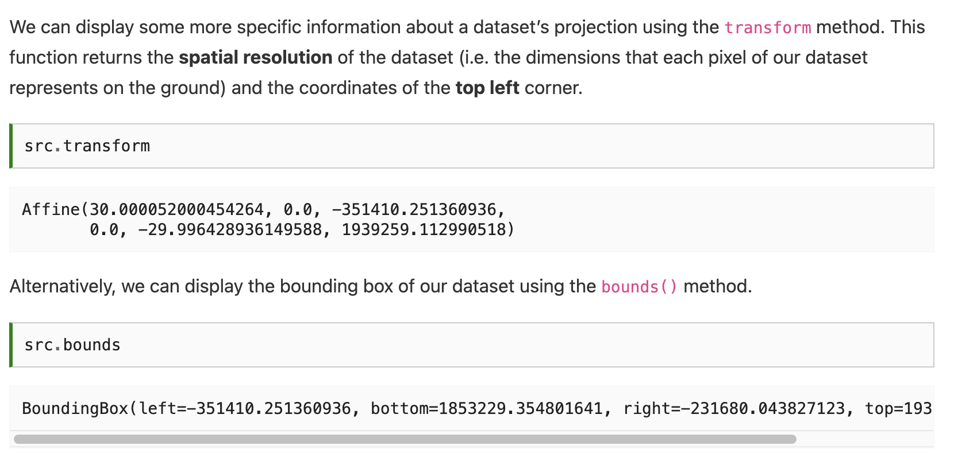

Slide 12
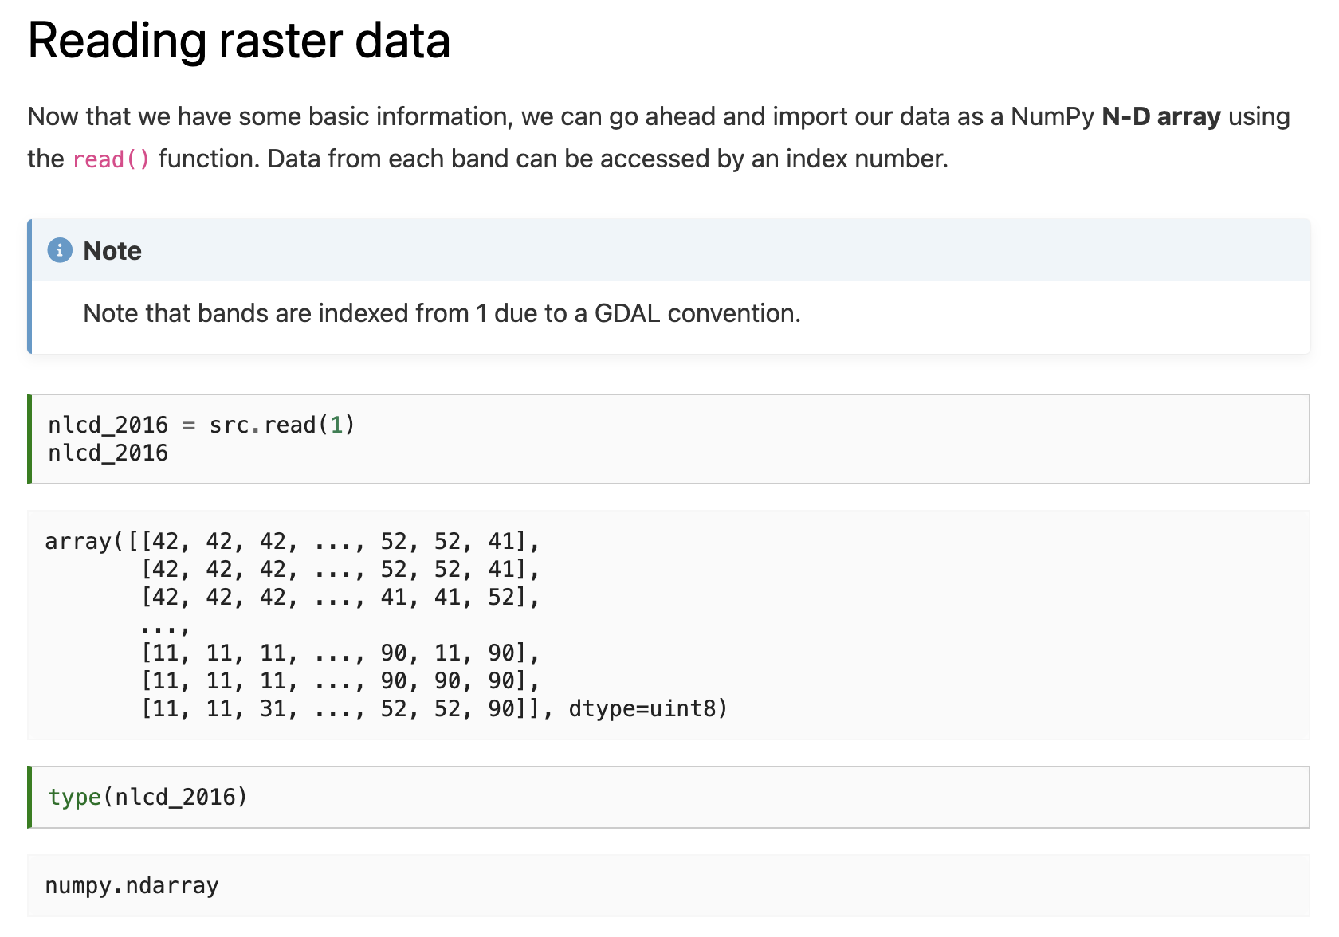

Slide 14
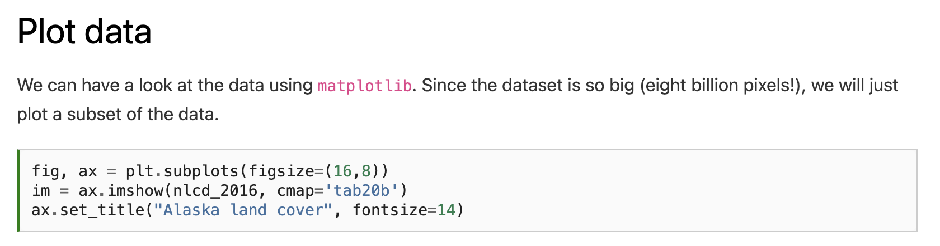
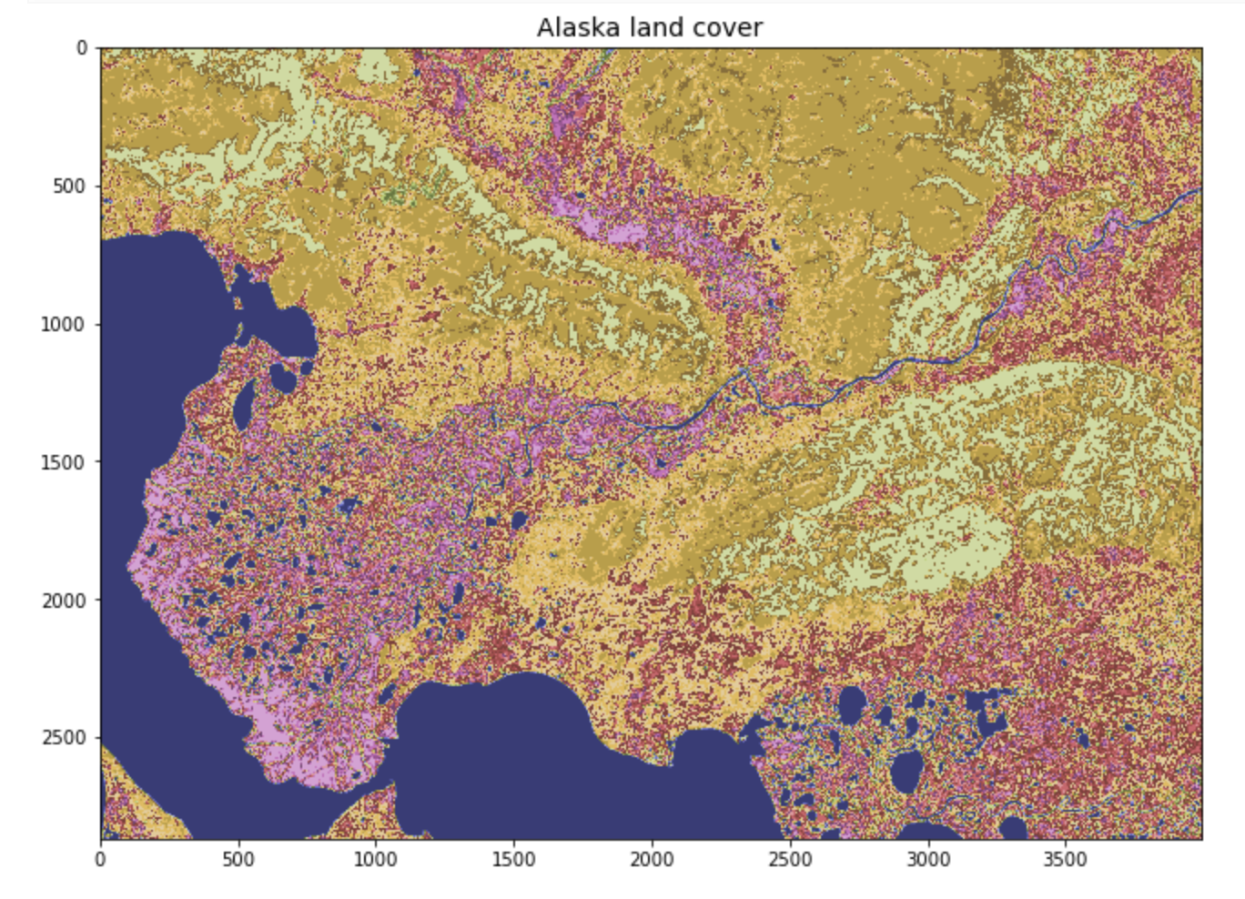

Slide 15
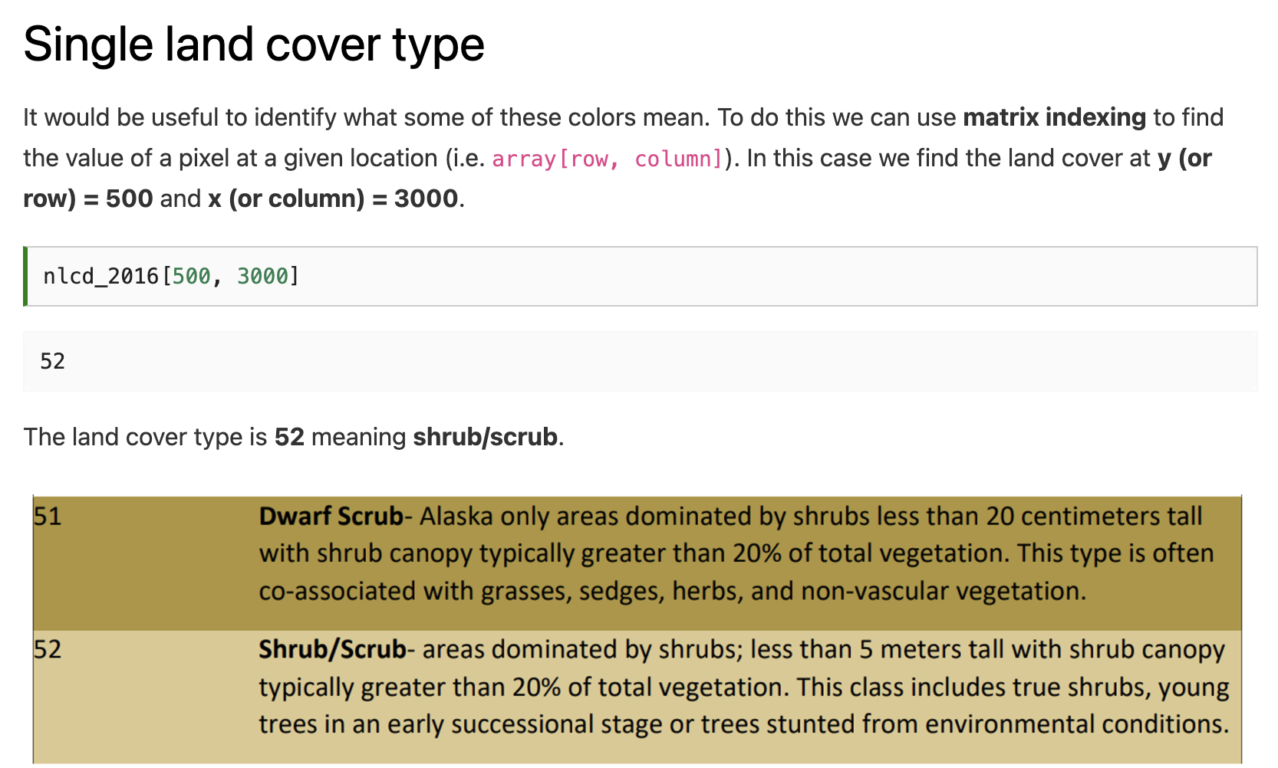

Slide 16
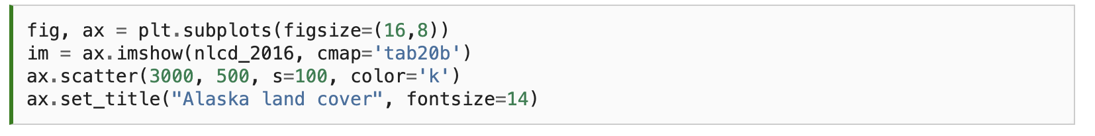
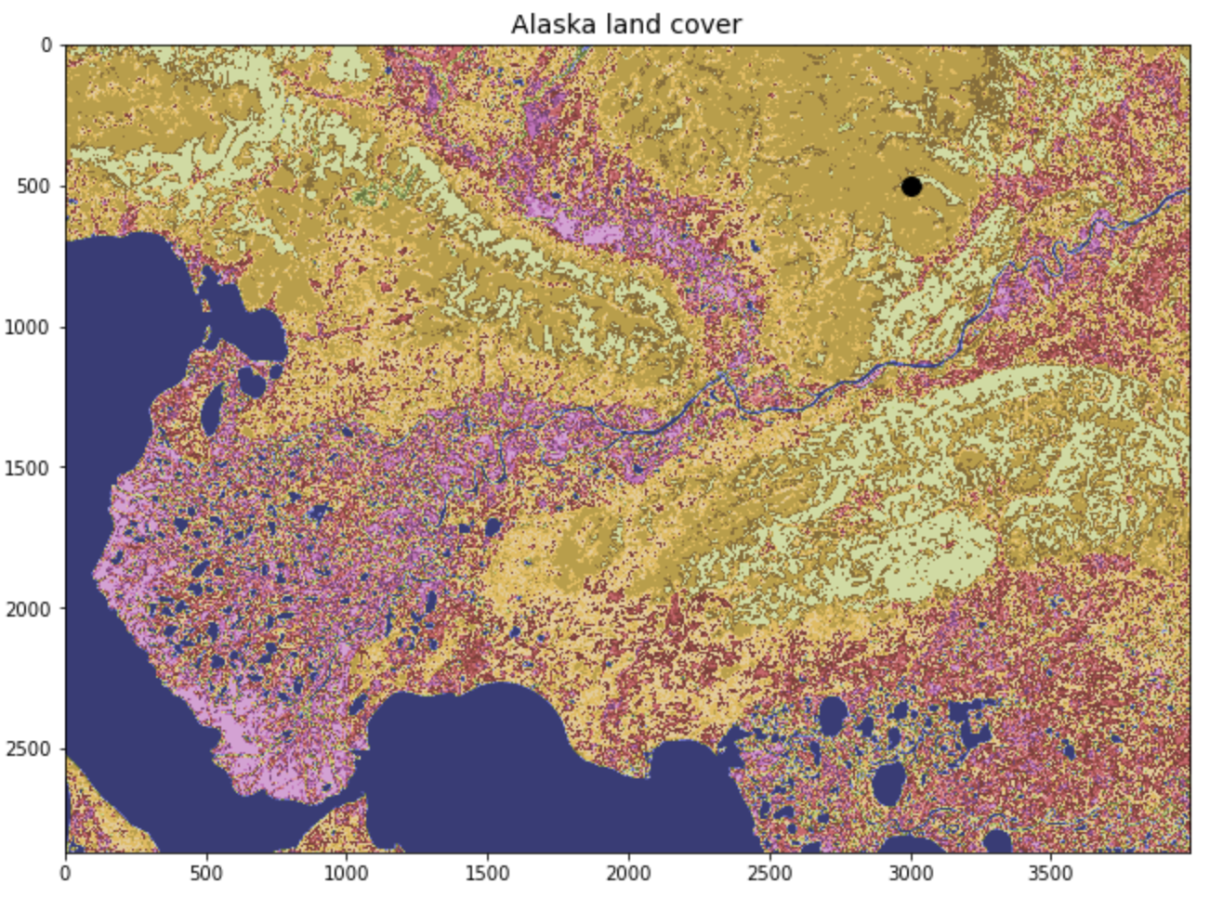

Slide 17
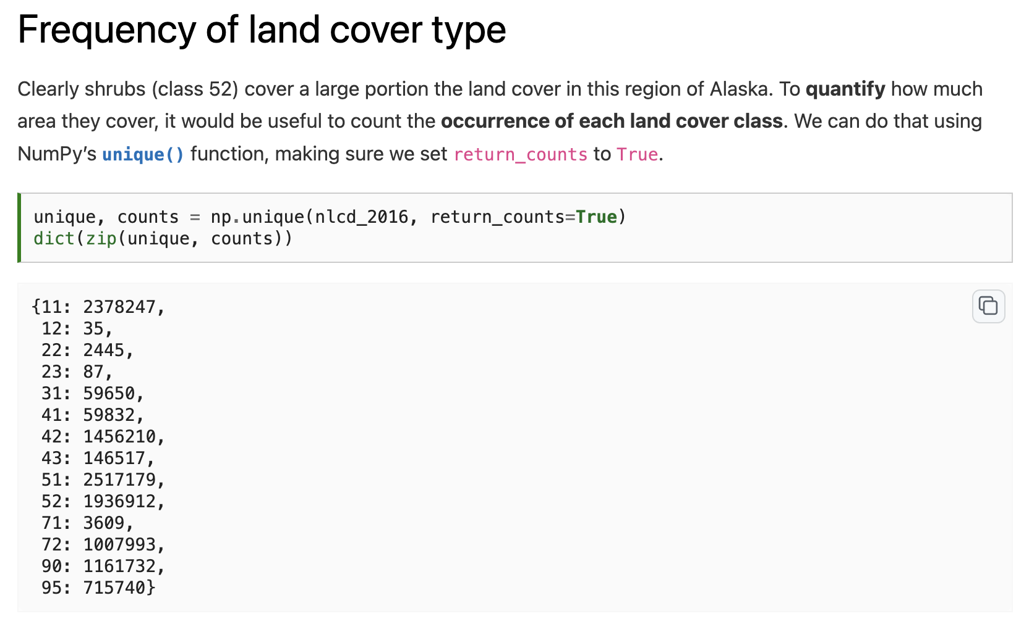

Slide 19
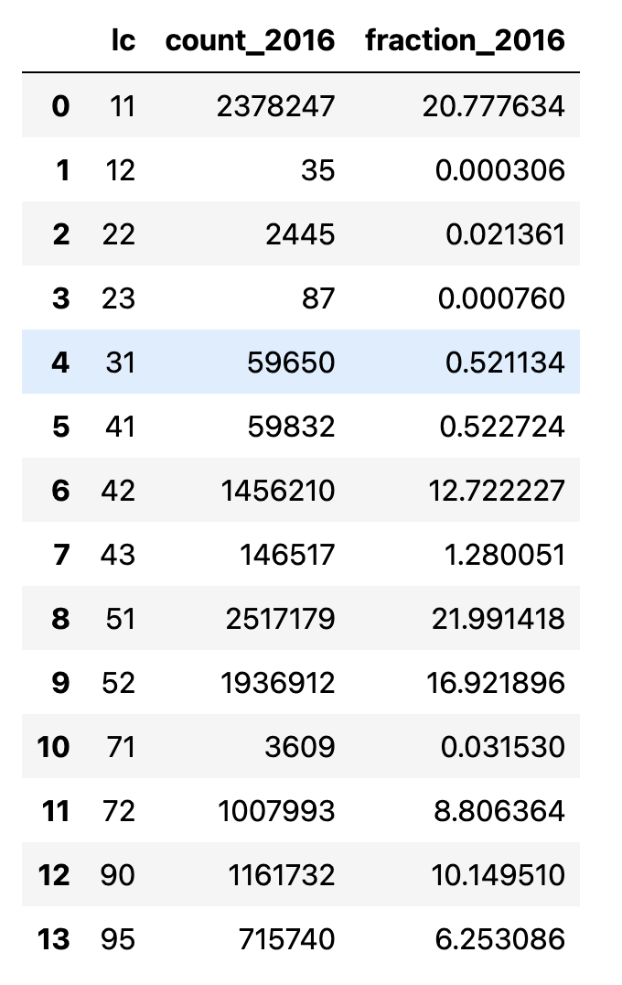
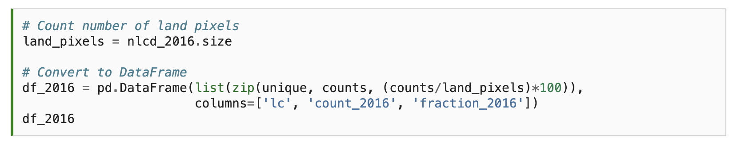

Slide 20
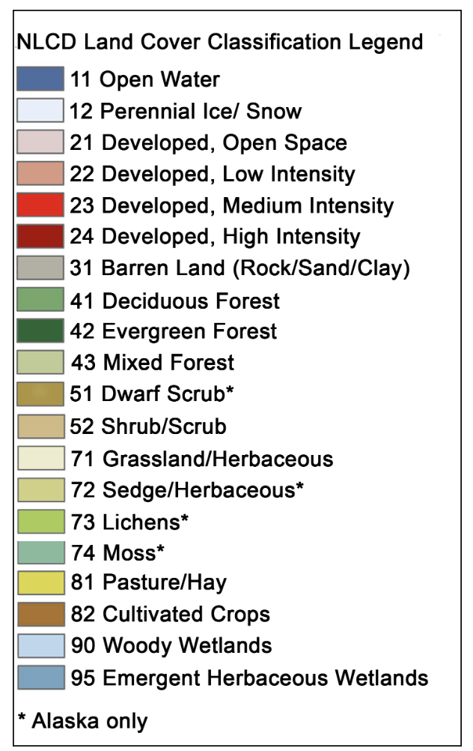

Slide 21
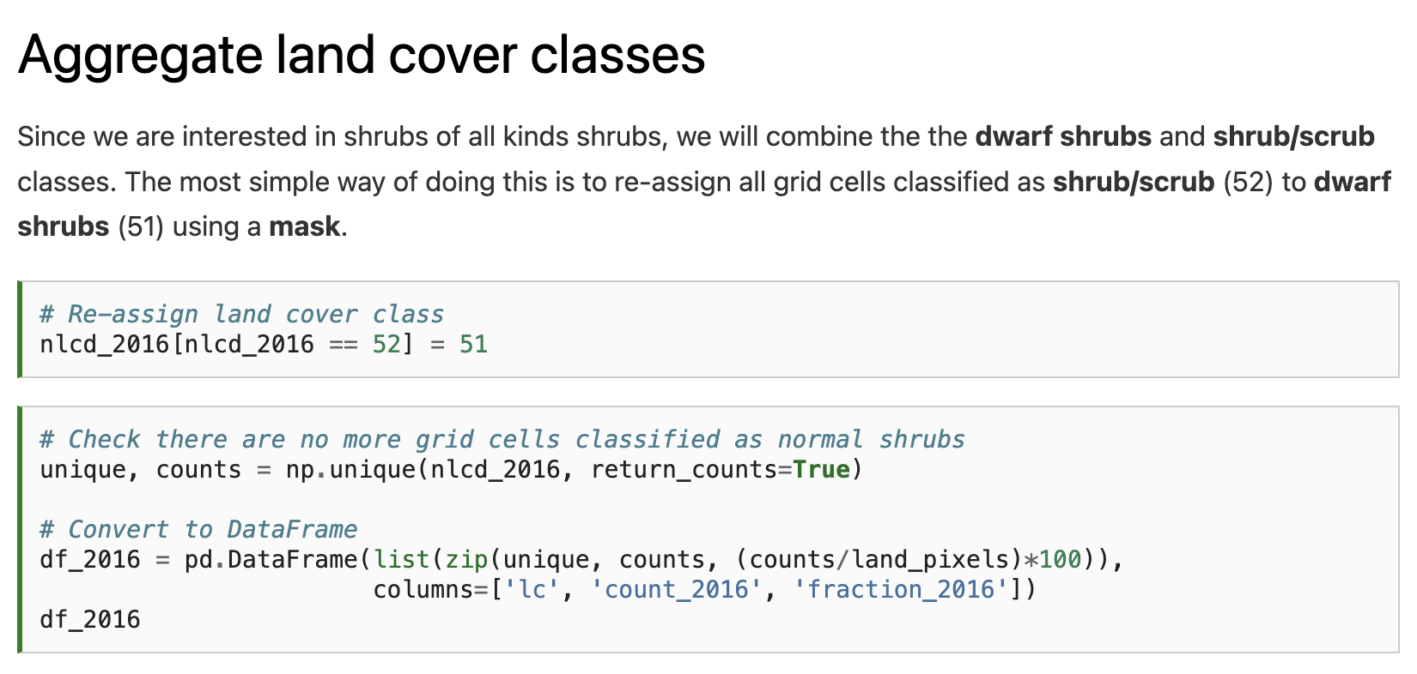

Slide 22
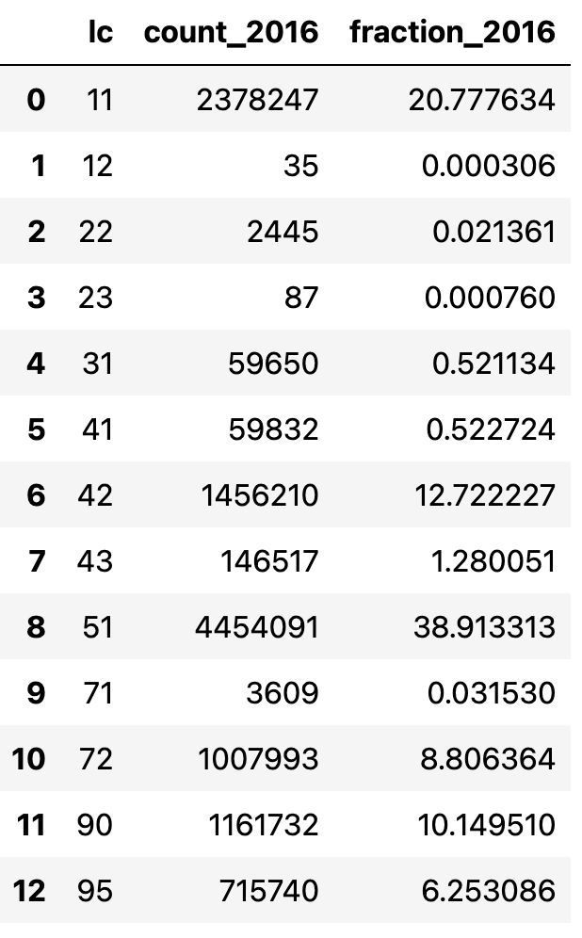

Slide 23
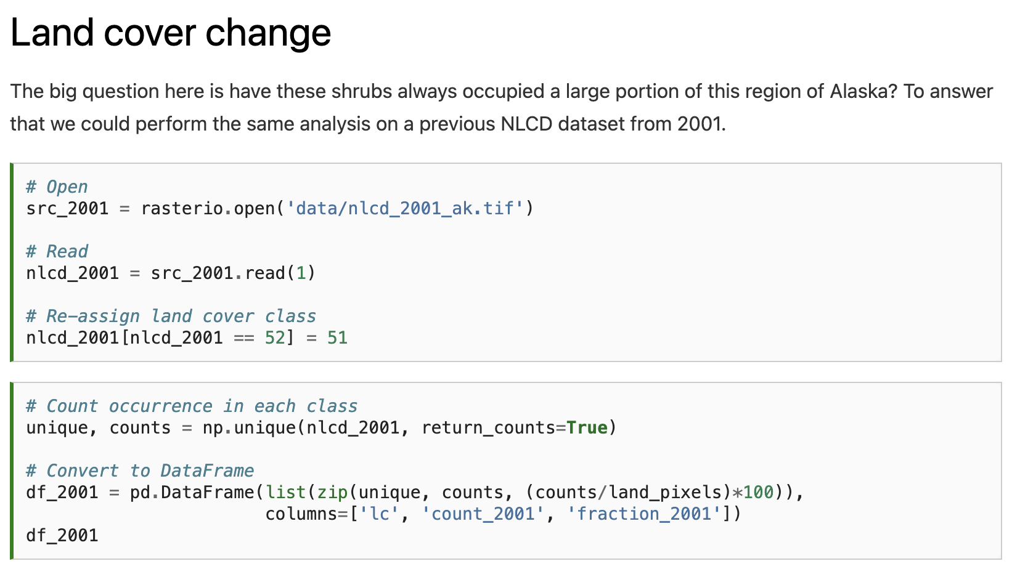
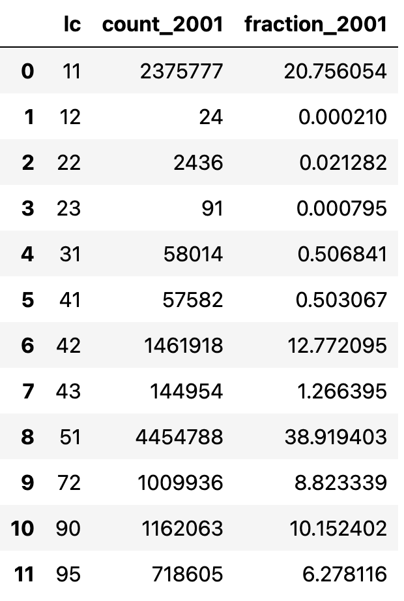

Slide 24
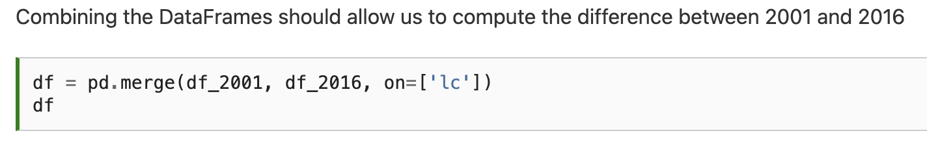
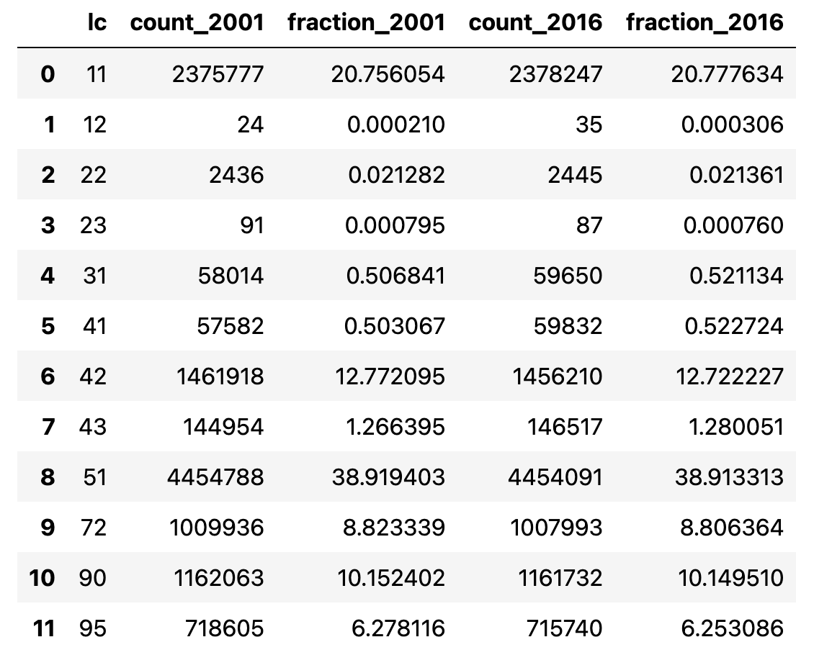

Slide 25
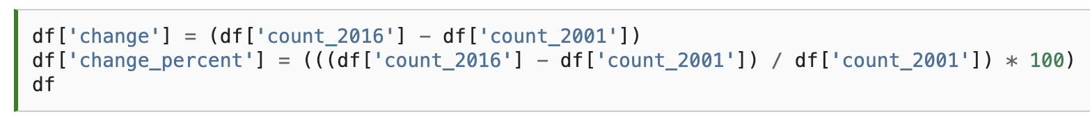
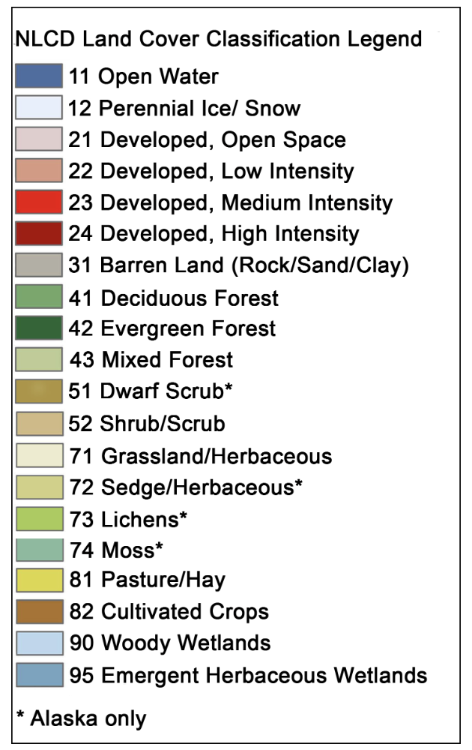
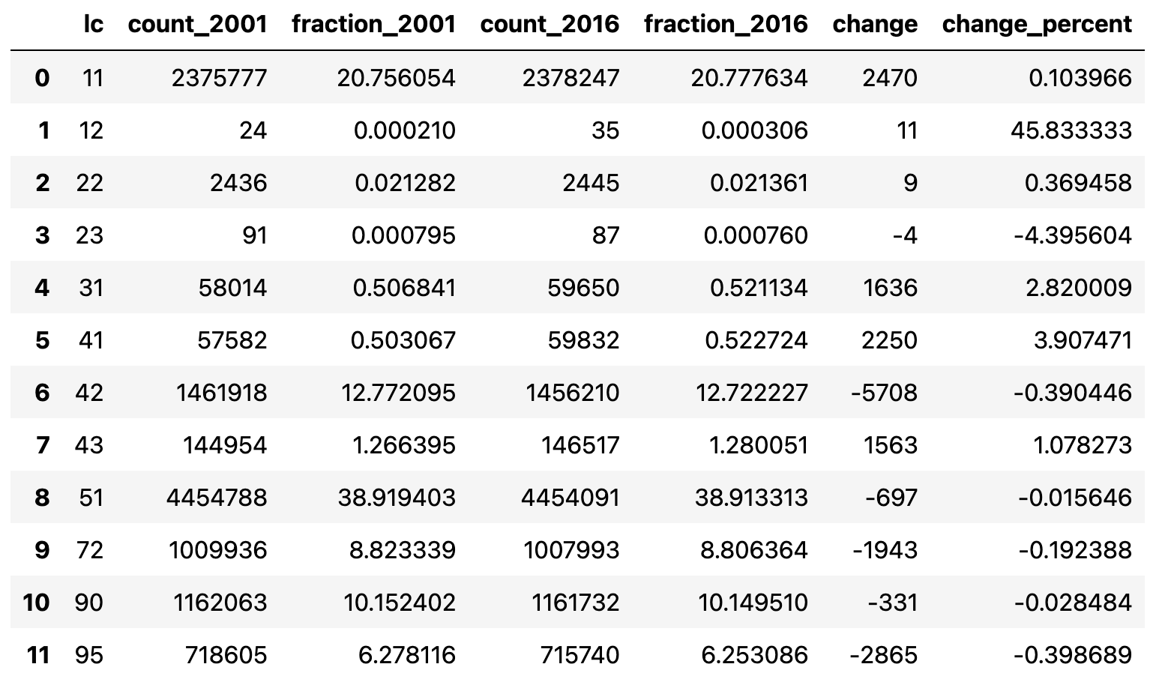
Notes:
Oh dear - the extent of shrubs did not increase between 2001 and 2016. One takeaway from this could be that shrubification is not happening in this region of the Arctic. But the percentage change in shrubs was very small (-0.02%) and could well be smaller than the uncertainty in our land cover product. For example, if just 1% of pixels were incorrectly classified as shrubs in 2001 our result would be insignificant. Other, perhaps more significant changes, that occurred between 2001 and 2016 include an increase in deciduous forest (41) by 3.9%, a decrease in evergreen forest (42) by 0.4%, and a decrease in emergent herbaceous wetlands (95) by 0.4%.

Slide 26
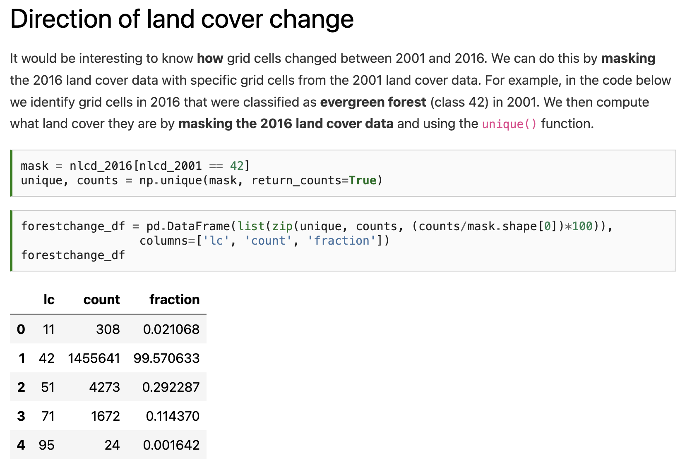

Slide 28
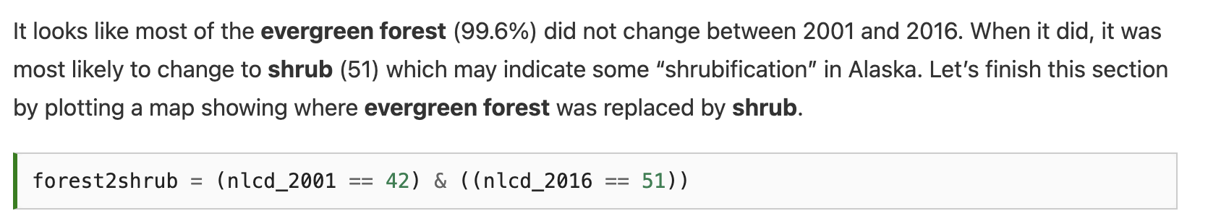

Slide 29
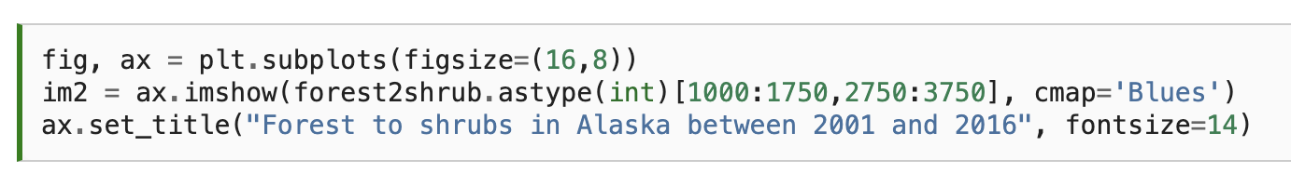
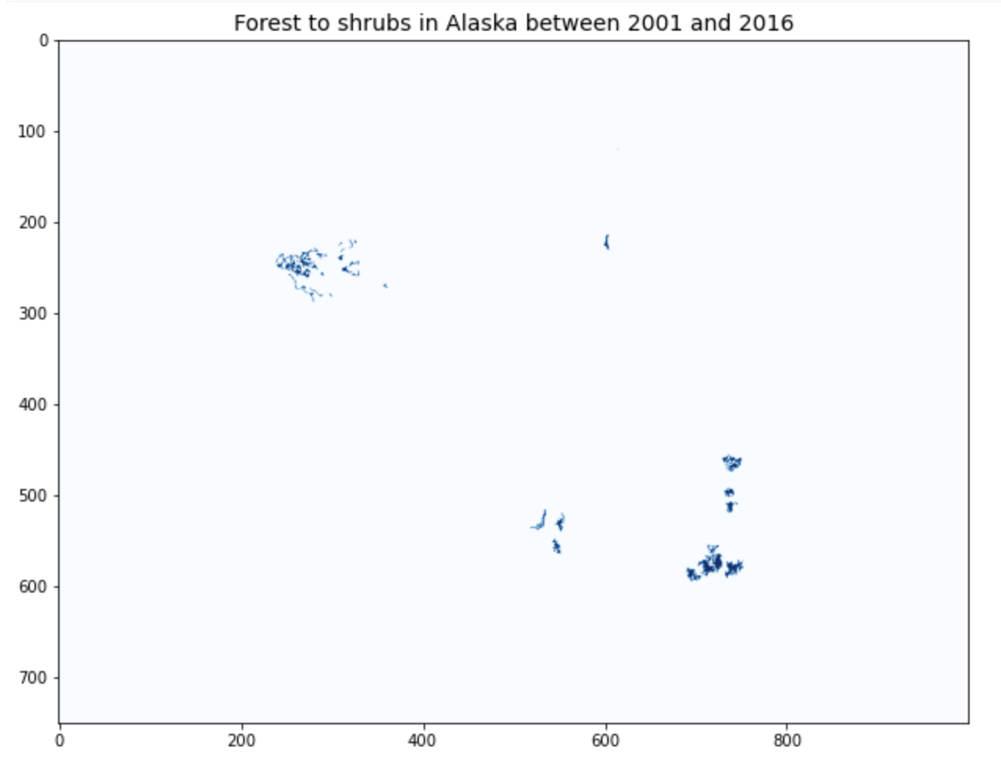

Slide 30
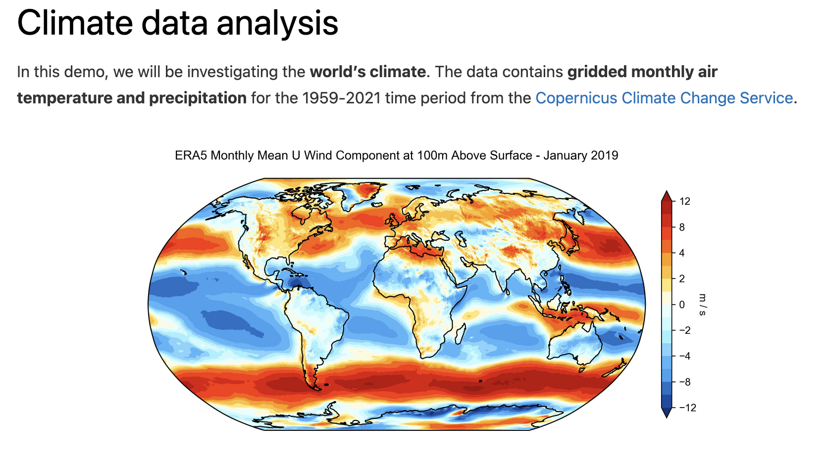

Slide 31
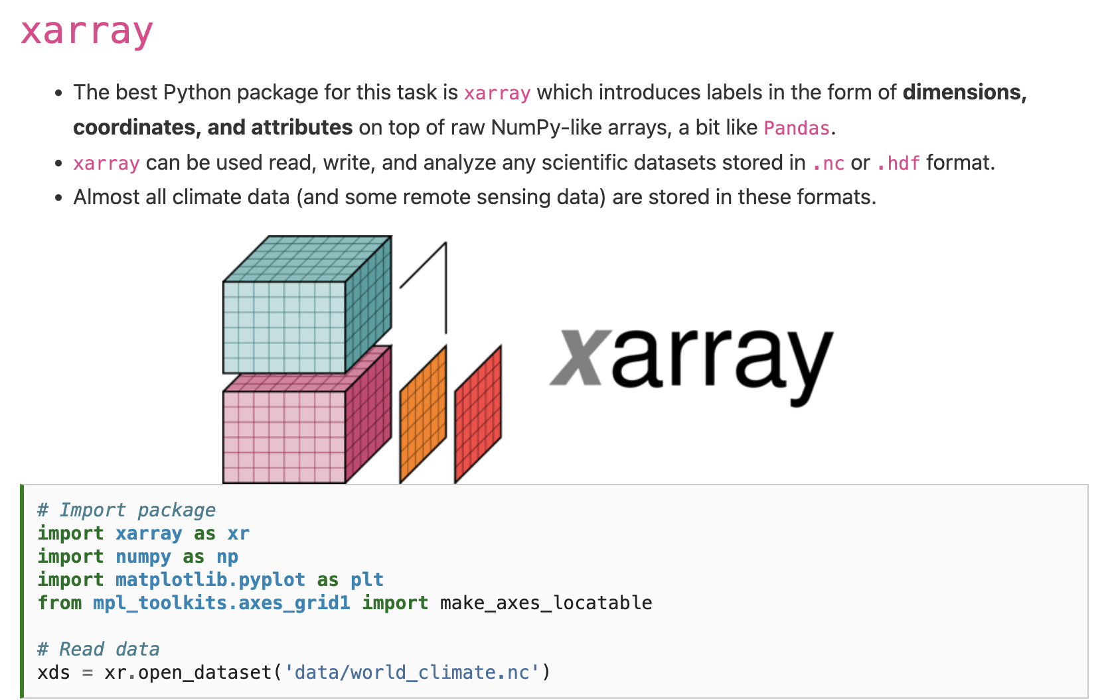

Slide 33
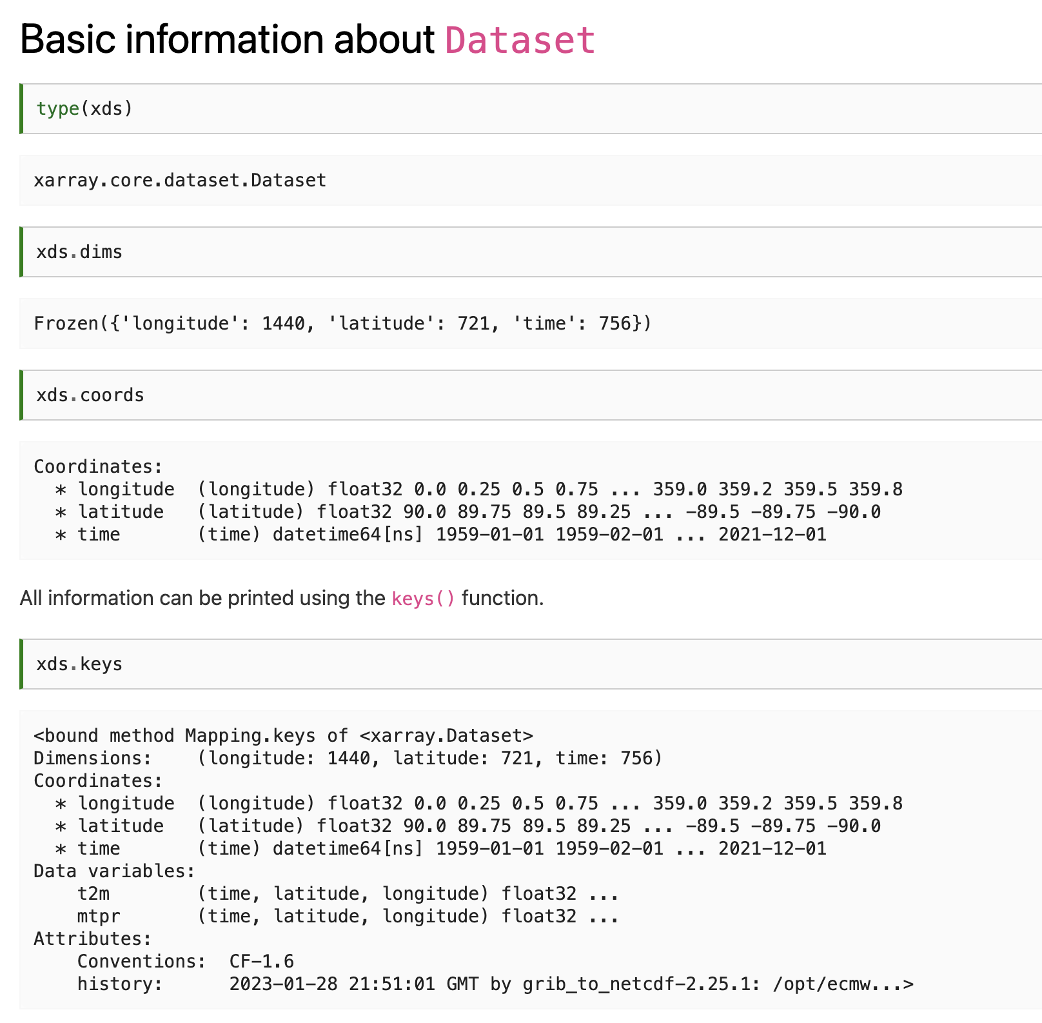

Slide 36
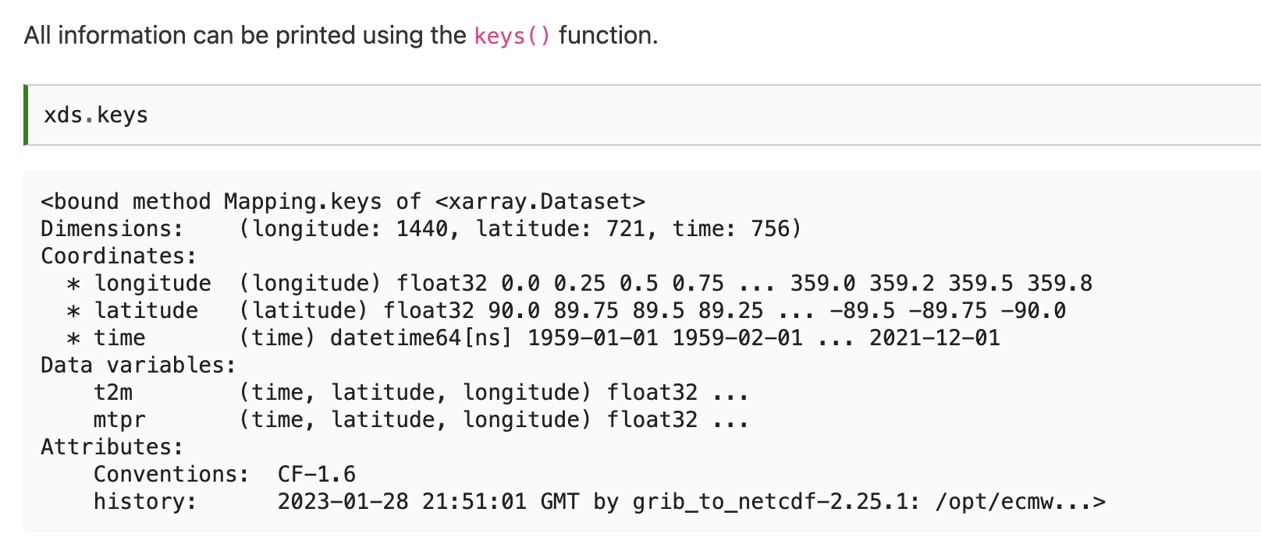
Notes:
t2m stands for 2 m above the surface, the standard height used by temperature sensors. It is a common metric used in climatology but note that it is different from the surface temperature which would be the temperature of the ground surface.

Slide 37
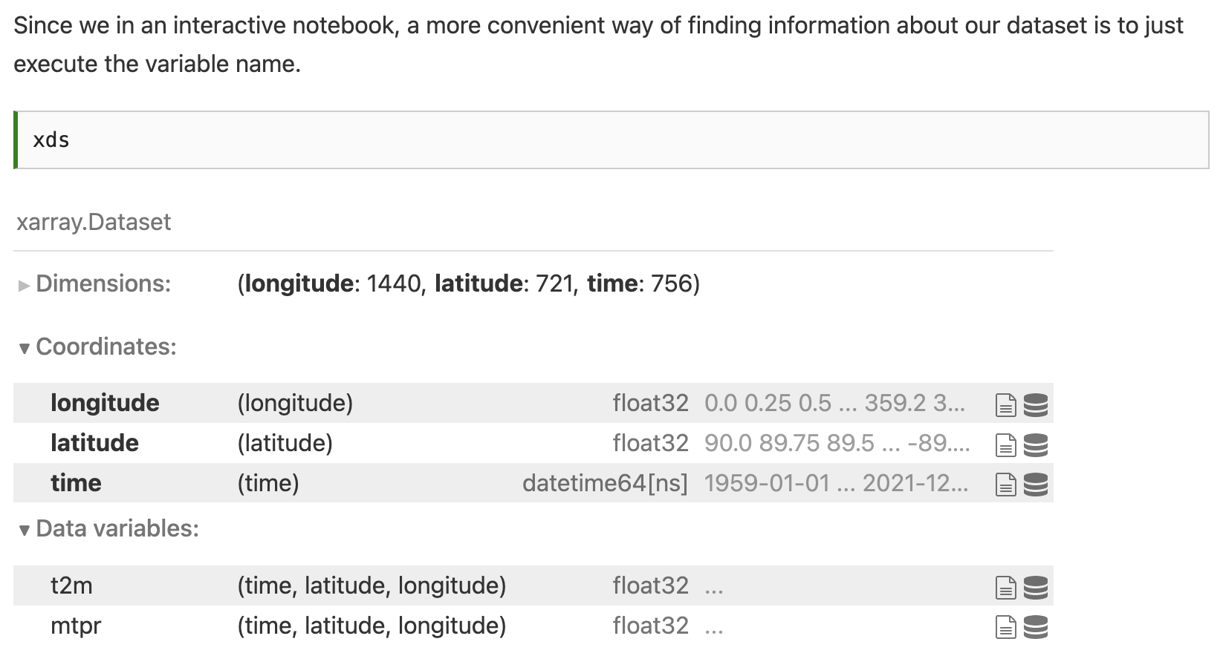
Notes:
\

Slide 38
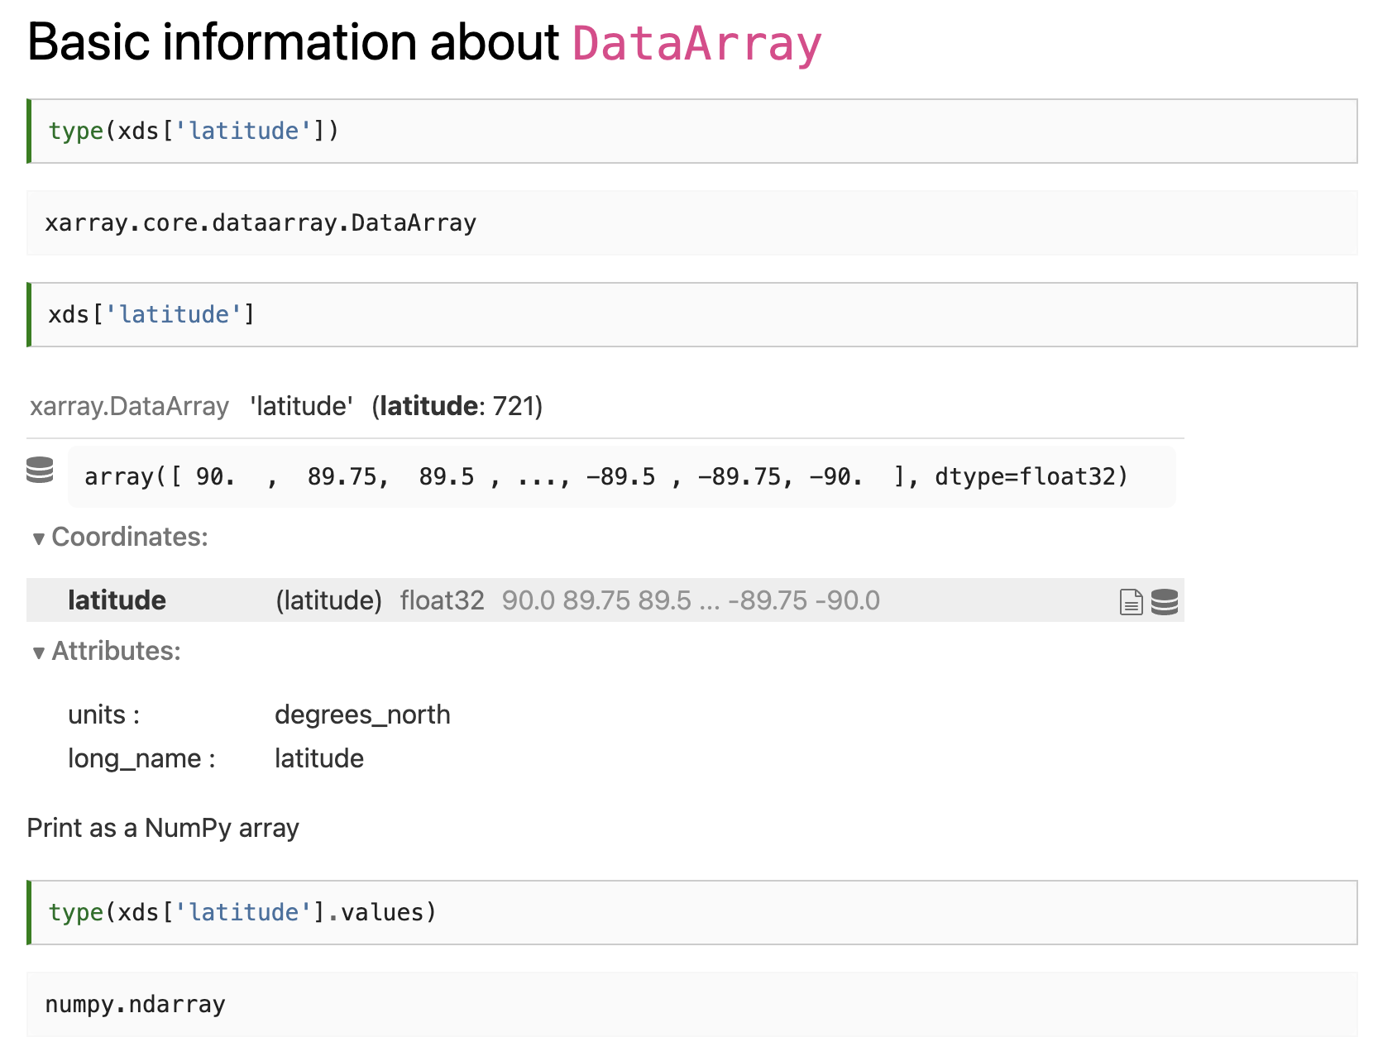
Notes:
\

Slide 39
Notes:
\

Slide 40
Notes:
\

Slide 41
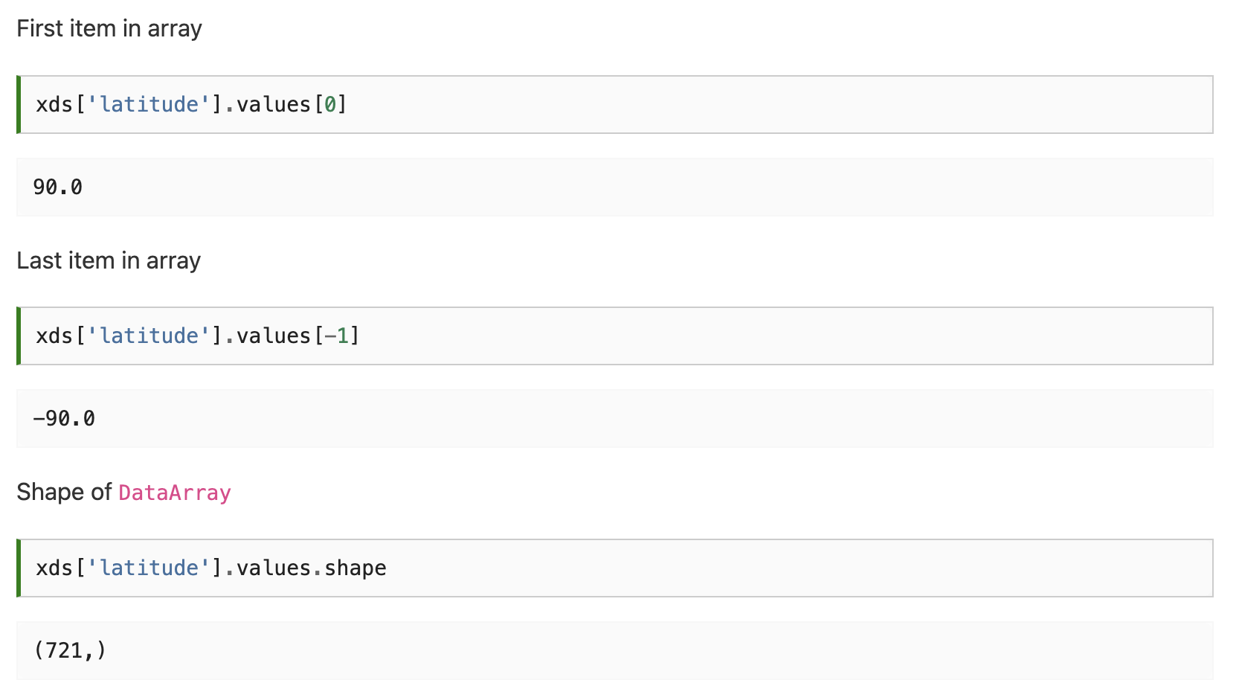
Notes:
\

Slide 42
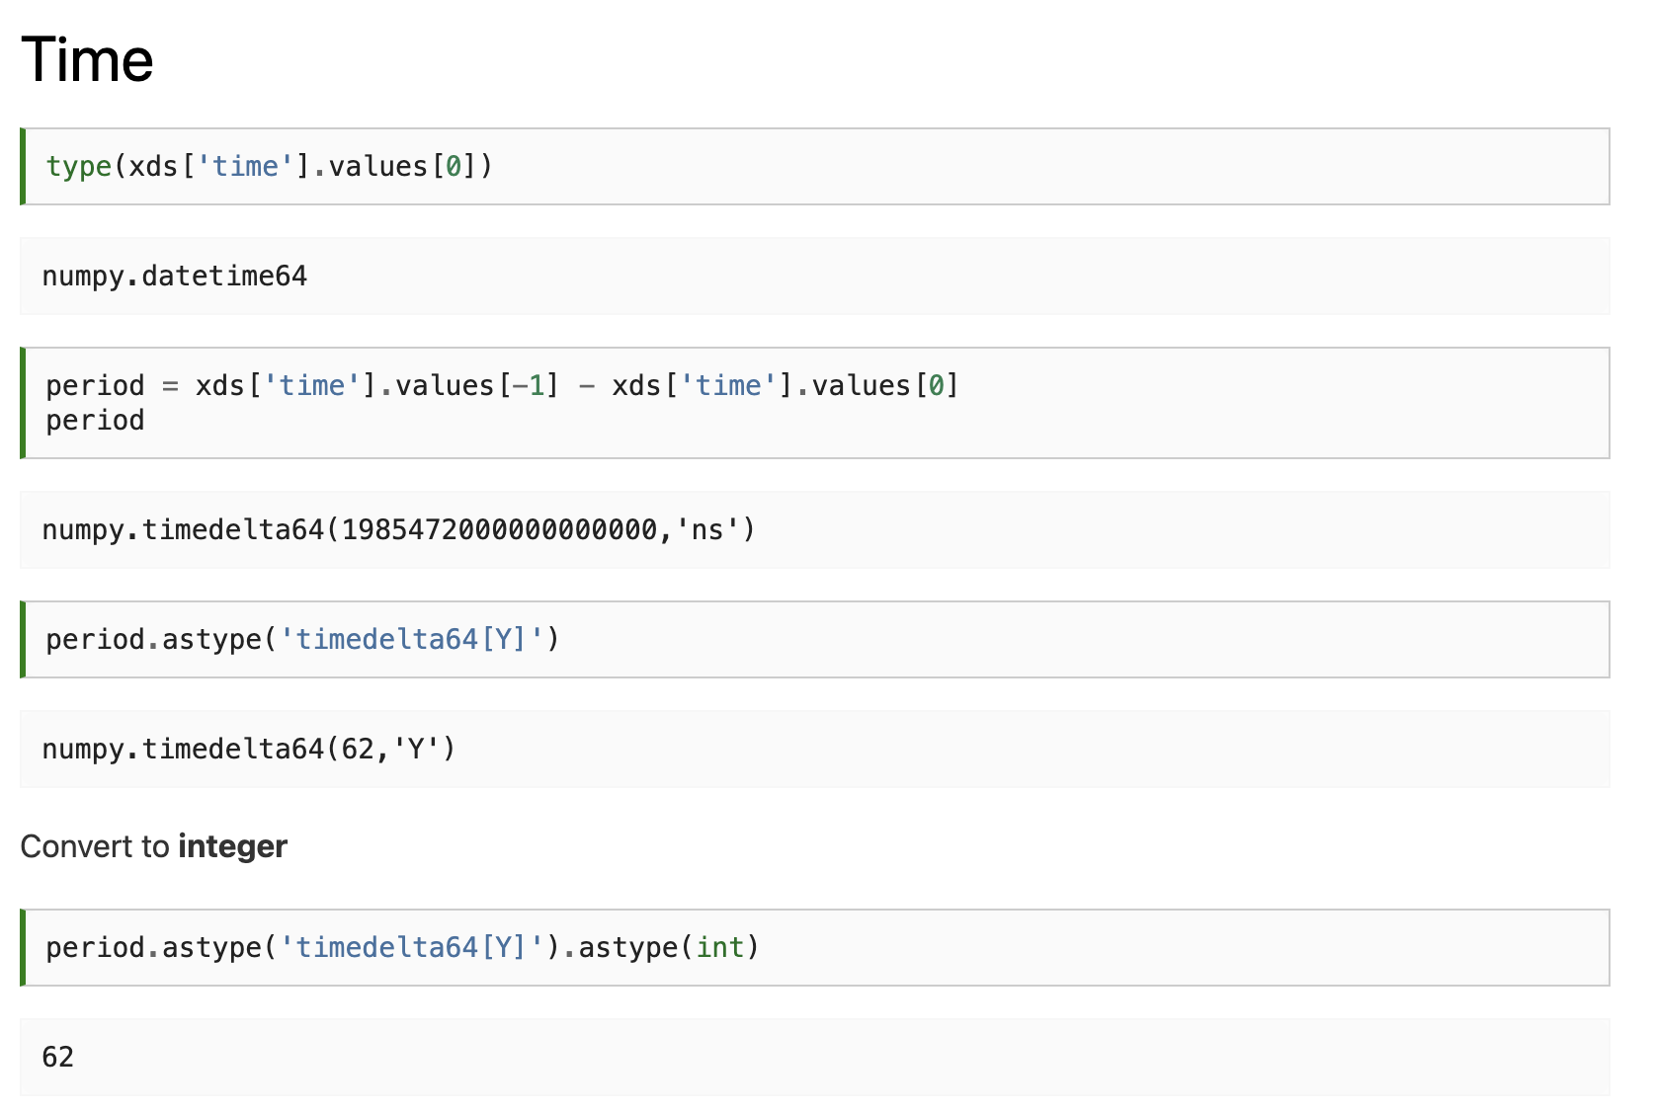
Notes:
\

Slide 43
Notes:
\

Slide 44
Notes:
\

Slide 45
Notes:
\

Slide 46
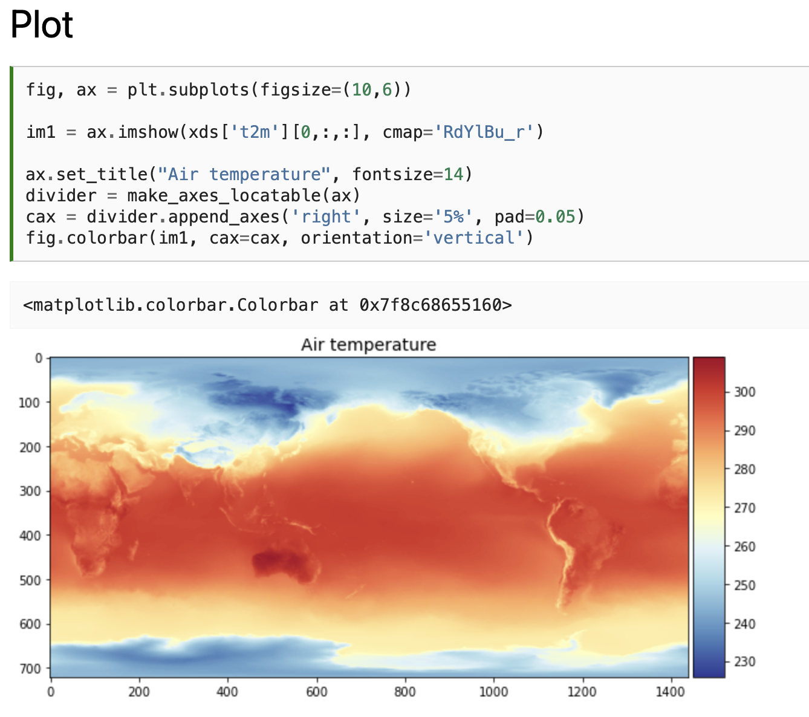
Notes:
\

Slide 47
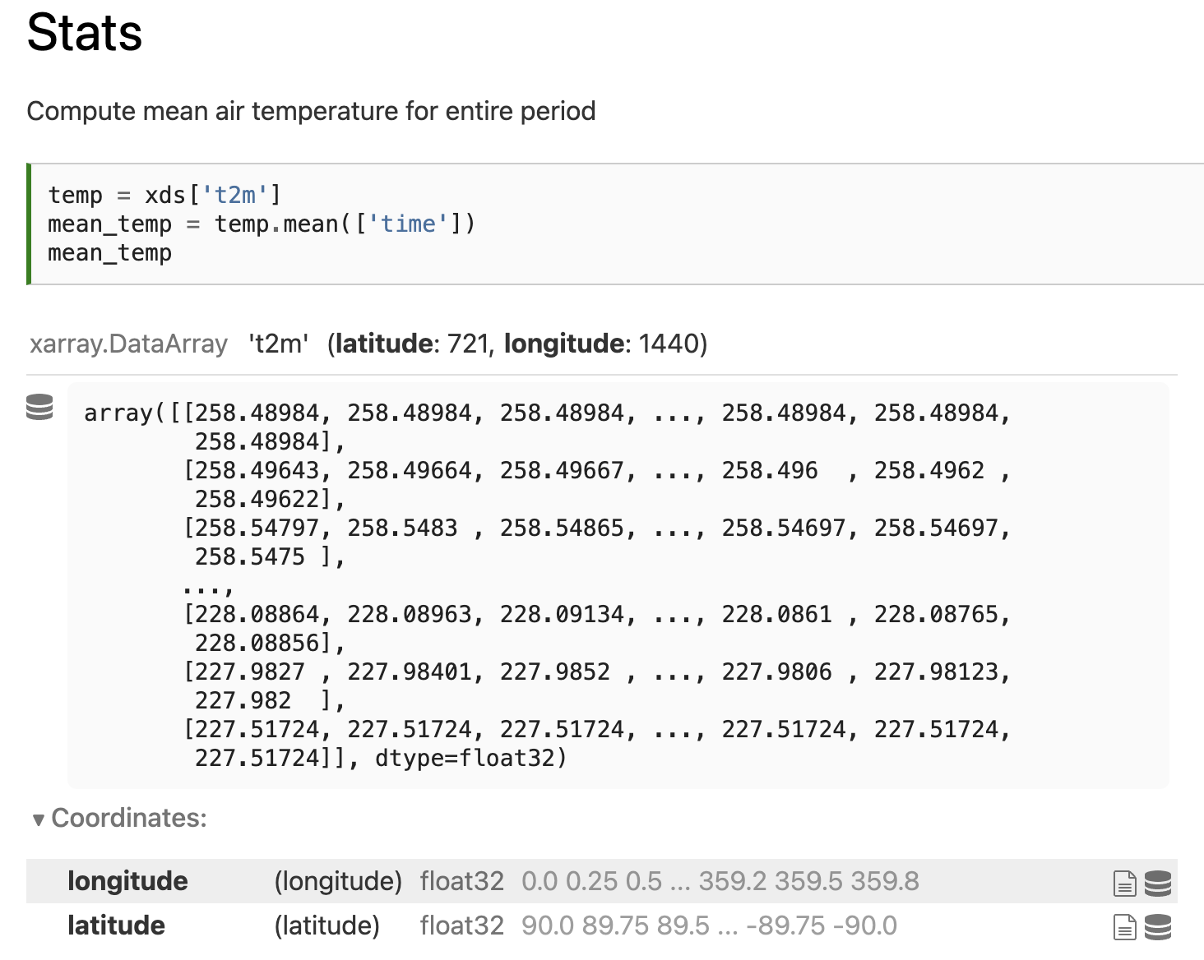
Notes:
\

Slide 48
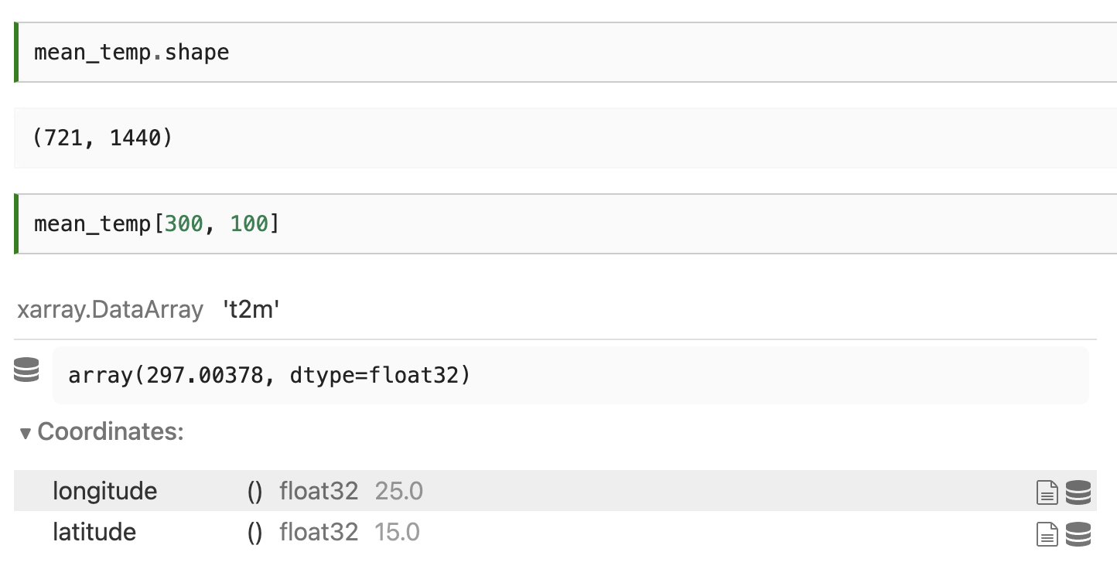
Notes:
\

Slide 49
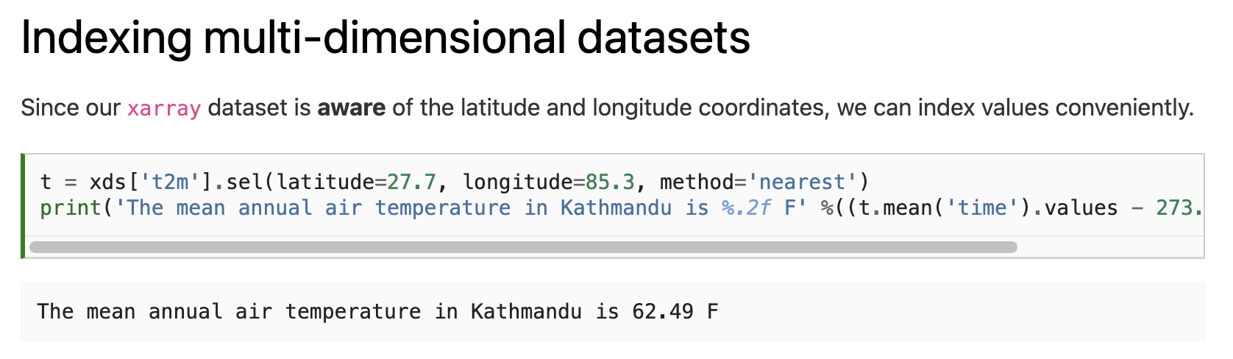
Notes:
\

Slide 50
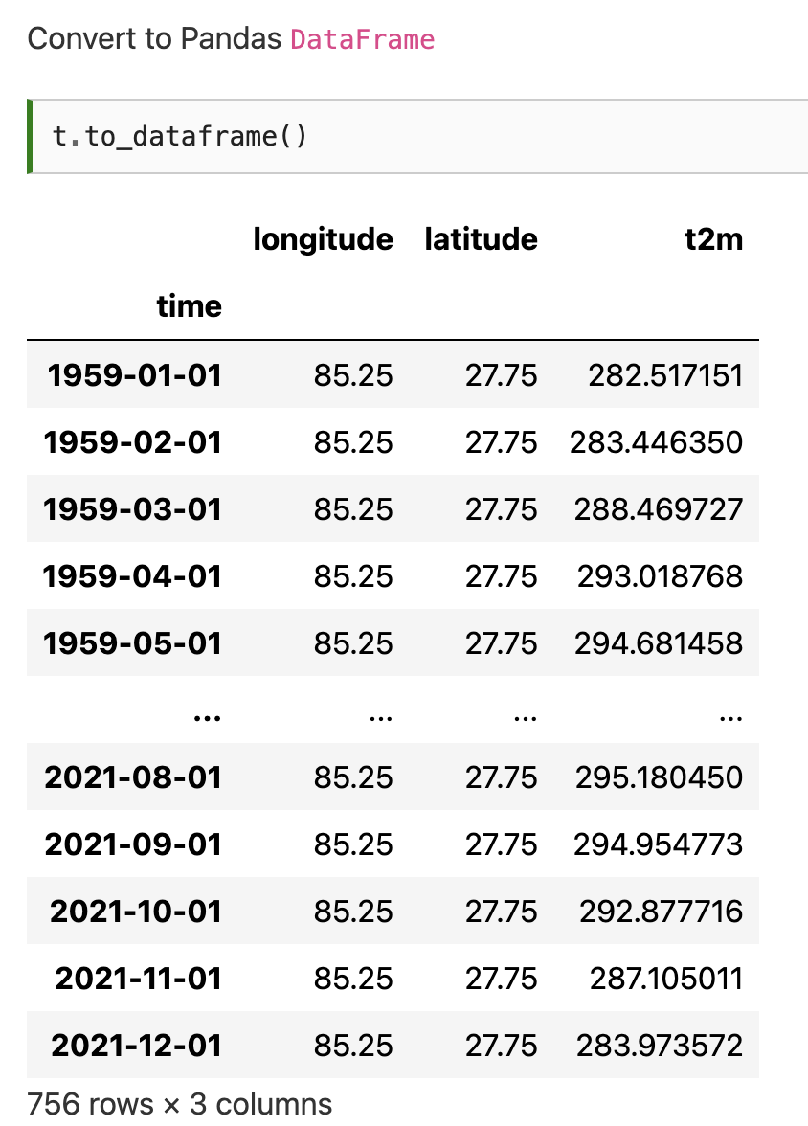
Notes:
\

Slide 51
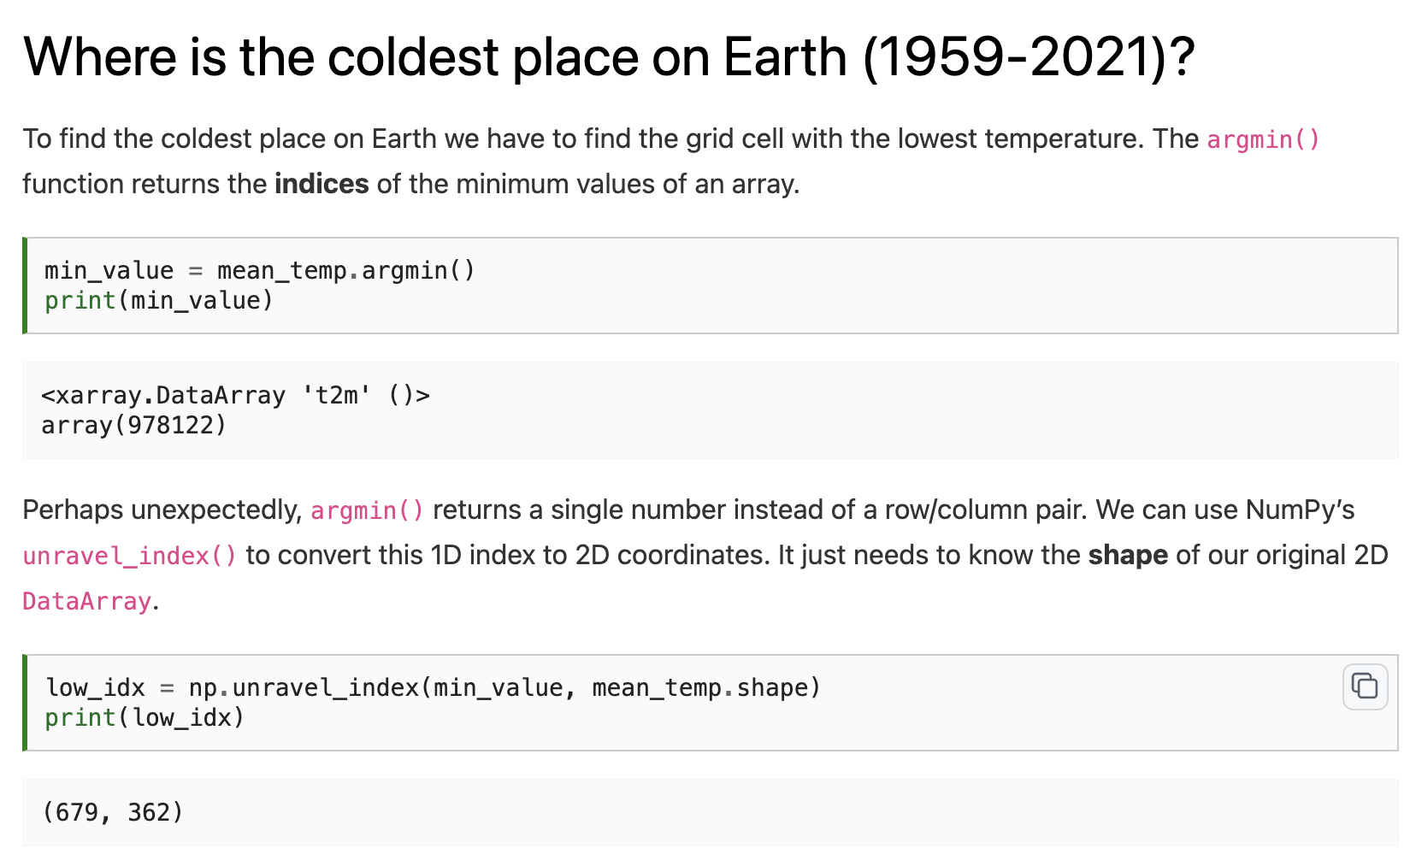
Notes:
\

Slide 52
Notes:
\

Slide 53
Notes:
\

Slide 54


Notes:
\

Slide 55

Notes:
\

Slide 56
Notes:
\

Slide 57

Notes:
\

Slide 58
Notes:
\

Slide 59

Notes:
\

Slide 60
Notes:
\

Slide 61
Next time: Machine learning
Email: jryan4@uoregon.edu
Office: 163A Condon Hall
Office hours: Monday 15:00-16:00 and Tuesday 14:00-15:00

